Slide 1
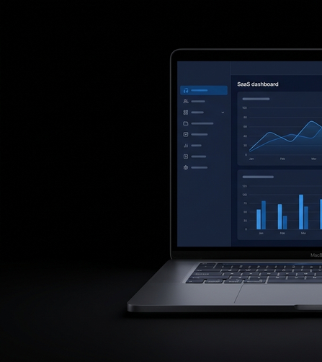
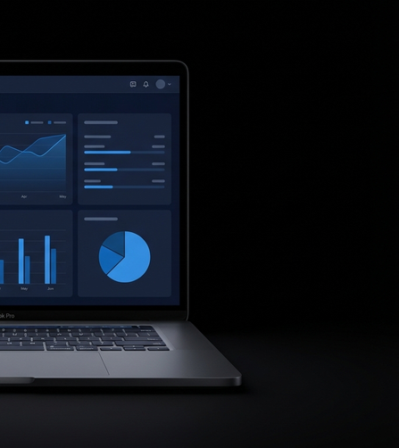
Spot the difference.
Custom Dev
The Agency
$150,000+
from $799
AVERAGE PROJECT COST
PER MONTH
Custom software. Off-the-shelf price.
The Agency •
built by Symph

